Slide 1



Department of Computer Science & Engineering
Multimodal Document Intelligence System for Invoice and Receipt Processing Using Vision-Language Models with Layout-Aware OCR
Presented by
Sriganth.G.V
Jayasimbu.J
Aadhiseshan.S
Remo.V
Guided By
Dr.P.Nandhini
HOD/CSE

Slide 2
Abstract
The project implements a multimodal document intelligence platform designed to automate information extraction from complex invoices and receipts. It combines the power of the Qwen2.5-VL model with advanced image enhancement techniques like CLAHE to process challenging documents, including handwritten and faded thermal receipts. The system supports over 10 Indic languages and generates a unique "Digital Twin" layout representation to maintain spatial accuracy. By leveraging a Master-Worker architecture, the system provides a scalable and cost-effective solution for intelligent data extraction, translating raw visual inputs into structured enterprise-ready JSON data

Slide 3
Problem Definition
Current invoice processing systems rely heavily on manual data entry or basic OCR techniques that extract raw text without understanding the document layout or semantic context. These traditional systems struggle with complex formats, diverse column structures, and nested tables, often losing the relationship between related fields like item names and their corresponding prices. Furthermore, existing solutions fail to handle low-quality mobile photographs, handwritten content on thermal receipts, and multilingual documents in regional Indian scripts. This gap in technology leads to high error rates, significant manual verification costs, and extreme inefficiency in modern enterprise financial workflows.

Slide 4
Literacy Survey
Traditional OCR and Text Extraction Research In the early stages of document intelligence, research focused primarily on Optical Character Recognition (OCR) engines like Tesseract and later PaddleOCR (Du et al., 2020). These studies demonstrated high accuracy in character recognition but revealed a significant limitation: the loss of spatial context. While these systems could extract raw text, they were unable to understand the relationship between different fields, such as associating a line item description with its price in a multi-column invoice layout.

Slide 5
Literacy Survey
Layout-Aware Neural Networks To address the limitations of plain OCR, researchers introduced models like LayoutLMv3 (Huang et al., 2022), which utilize multi-modal transformers to process text, image, and position (bounding boxes) simultaneously. This research proved that understanding the visual "geometry" of a document is essential for accurate field extraction. However, these models still required a separate OCR engine to provide text hints, making the entire pipeline dependent on the accuracy of the initial text recognition step.

Slide 6
Literacy Survey
Vision-Language Models (VLM) & Visual Reasoning Recent breakthroughs in Large Multimodal Models, such as Qwen2.5-VL (Bai et al., 2024) or MiniCPM-V (Hu et al., 2024), have pioneered the concept of "Visual Reasoning." These studies show that advanced Vision Transformers (ViT) can natively interpret document images as a whole, eliminating the need for rigid templates or external OCR engines. Our project builds on this research by implementing a distributed master-worker architecture to bring this 32B-parameter level of intelligence to consumer-grade hardware.

Slide 7

Existing System
Existing systems mainly use basic OCR techniques that extract only raw text without understanding document structure. These systems fail to handle complex invoice layouts, handwritten text, and multilingual content effectively. Most solutions require manual verification and correction, making the process slow and inefficient.
Problems in Existing System:
Cannot understand document layout properly
Poor accuracy in handwritten and multilingual data
Requires manual data correction
Does not extract structured fields effectively

Slide 8
Proposed System
Our proposed system introduces a Distributed Multimodal Intelligence solution that integrates high-precision Vision-Language Models with intelligent local pre-processing. By utilizing an end-to-end visual reasoning approach, the system "sees" and understands the document layout just like a human assistant, enabling it to extract structured data directly into standardized formats without the need for rigid templates. The architecture bridges the hardware gap by offloading heavy 32B-parameter model inference to remote Kaggle GPU workers through secure tunnels, ensuring that enterprise-grade AI performance can be achieved even on standard consumer-grade computers.

Slide 9
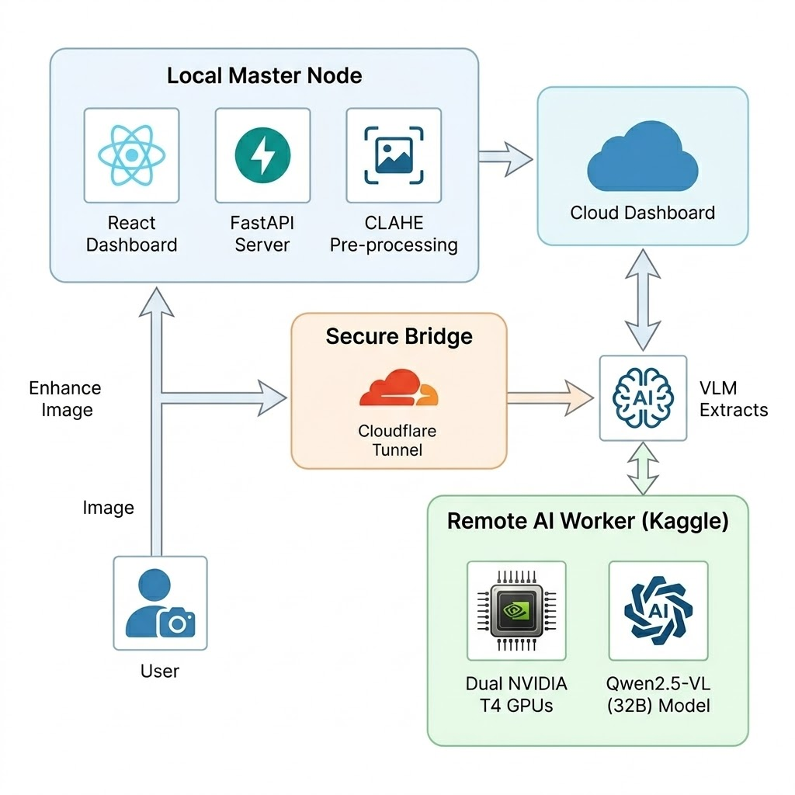
System Architecture

Slide 10
Technologies Used
Frontend Technologies: The user interface is built using React.js combined with TailwindCSS for a responsive, premium dashboard experience. We utilize Axios for API communication and React for consistent, modern iconography.
Backend Infrastructure: The server logic is powered by FastAPI (Python), chosen for its high performance and native support for asynchronous programming. Uvicorn serves as the lightning-fast ASGI server, while Pydantic ensures strict data validation.
AI & ML Core: The project leverages the Qwen2.5-VL-32B and MiniCPM-V 2.6 models for multimodal visual reasoning. Inference is managed via the Llama-cpp (GGUF) engine, allowing for high-performance execution of quantized models.

Slide 11
Technologies Used
Image Processing & Vision: We utilize OpenCV (Open Source Computer Vision Library) and Pillow (PIL) for core image operations. The CLAHE algorithm and Custom Segment Splitting logic are implemented to optimize input for the VLM.
Deployment & Networking: The system uses a distributed architecture with Kaggle Dual-T4 GPUs acting as the remote worker. Secure communication between the local master and remote worker is established through a Cloudflare Tunnel (argo-tunnel).
Database & Storage: MongoDB is used as the primary NoSQL database for flexible storage of extraction results. Motor provides an asynchronous driver for MongoDB, ensuring that database operations never block the processing pipeline.

Slide 12
Techniques
1. Vision Transformer (ViT) Spatial Attention: The core of our extraction technique lies in the Vision Transformer architecture, which employs spatial self-attention mechanisms. Unlike traditional models that process text in a linear sequence, ViT allows the AI to "see" the entire document at once, enabling it to understand the complex spatial relationships between different layout blocks, such as matching a total amount to its corresponding label across the page.
2. Master-Worker Hardware Offloading: To overcome the hardware limitations of 4GB VRAM machines, we implemented a distributed offloading technique. This mechanism segments the workload, keeping sensitive pre-processing and user management on the local "Master" node while securely tunneling the heavy 32B-parameter VLM inference tasks to a high-performance "Worker" node equipped with Dual-T4 GPUs.

Slide 13
Techniques
3. Quantized GGUF & 4-bit Normalization: To ensure high processing speed and reduced latency, we utilize GGUF-formatted quantized models. By normalizing the Vision-Language Model weights into 4-bit precision, we significantly reduce the computational footprint without compromising the model's ability to understand fine-grained details in handwritten text and complex multilingual scripts.
4. Real-time SSE Stream Communication: We utilize Server-Sent Events (SSE) to manage the communication between the backend and frontend. This technique allows for a persistent, unidirectional data stream that provides the user with real-time feedback on every processing stage—from image enhancement to final JSON generation—ensuring a responsive and transparent user experience.

Slide 14
Algorithm
1. Adaptive Image Enhancement (CLAHE): The process begins with Contrast Limited Adaptive Histogram Equalization to restore visibility on faded or low-contrast thermal receipts. This algorithm enhances local details without over-exposing the image, ensuring that small text remains legible for the AI.
2. Dynamic Resolution & Splitting: To maintain high precision, a custom logic resizes images into optimized patches while preserving aspect ratios. For extremely tall documents, a dynamic splitting algorithm cuts the invoice into overlapping segments to prevent data loss at the edges.
3. Structured JSON Decoding: In the final stage, the raw textual output from the model is passed through a greedy decoding process. This parses the AI’s visual interpretations into a clean, hierarchical JSON format, which is then stitched back together if the image was split.

Slide 15
Mechanism
1. Distributed Master-Worker Offloading: The system utilizes a unique architecture where lightweight tasks like image prep are handled locally (Master), while heavy AI inference is offloaded to remote Kaggle Dual-T4 GPUs (Worker) to overcome local hardware limitations.
2. Spatial Self-Attention & Visual Reasoning: Instead of traditional sequential OCR, the system uses a Vision Transformer mechanism. This allows the AI to "visually reason" by looking at the entire document layout simultaneously to understand relationships between headers and values.
3. Secure Tunneling & Asynchronous Polling: Data transfer is managed through an encrypted Cloudflare Tunnel, ensuring security between nodes. An asynchronous polling mechanism tracks the remote job status, streaming real-time updates to the frontend until processing is complete.

Slide 16

Modules
1. Image Intelligence & Pre-processing Module: This module acts as the "Eyes" of the system, handling initial document acquisition, deskewing, and the application of enhancement filters like CLAHE and Segment Splitting to prepare the image for the AI brain.
2. Remote VLM Inference & Logic Module: Residing on the high-performance worker node, this module performs the core extraction. It uses the Qwen2.5-VL engine to natively read 10+ Indic languages and interpret complex layouts to generate a "Digital Twin" of the document.
3. Data Standardization & Visualization Module: The final module receives raw AI results and applies fuzzy matching logic to map them to a standard enterprise schema. It then visualizes the results on a React dashboard, providing both structured data and a spatial layout map.

Slide 17
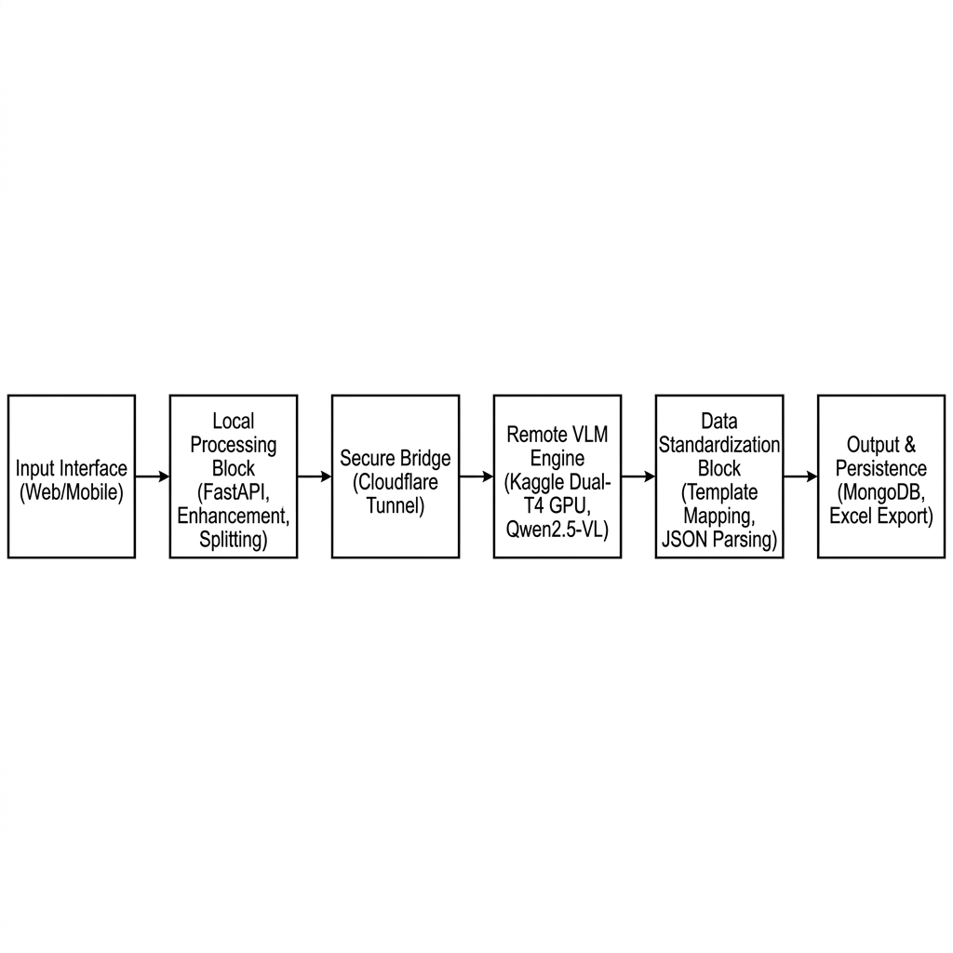
Block Diagram

Slide 18
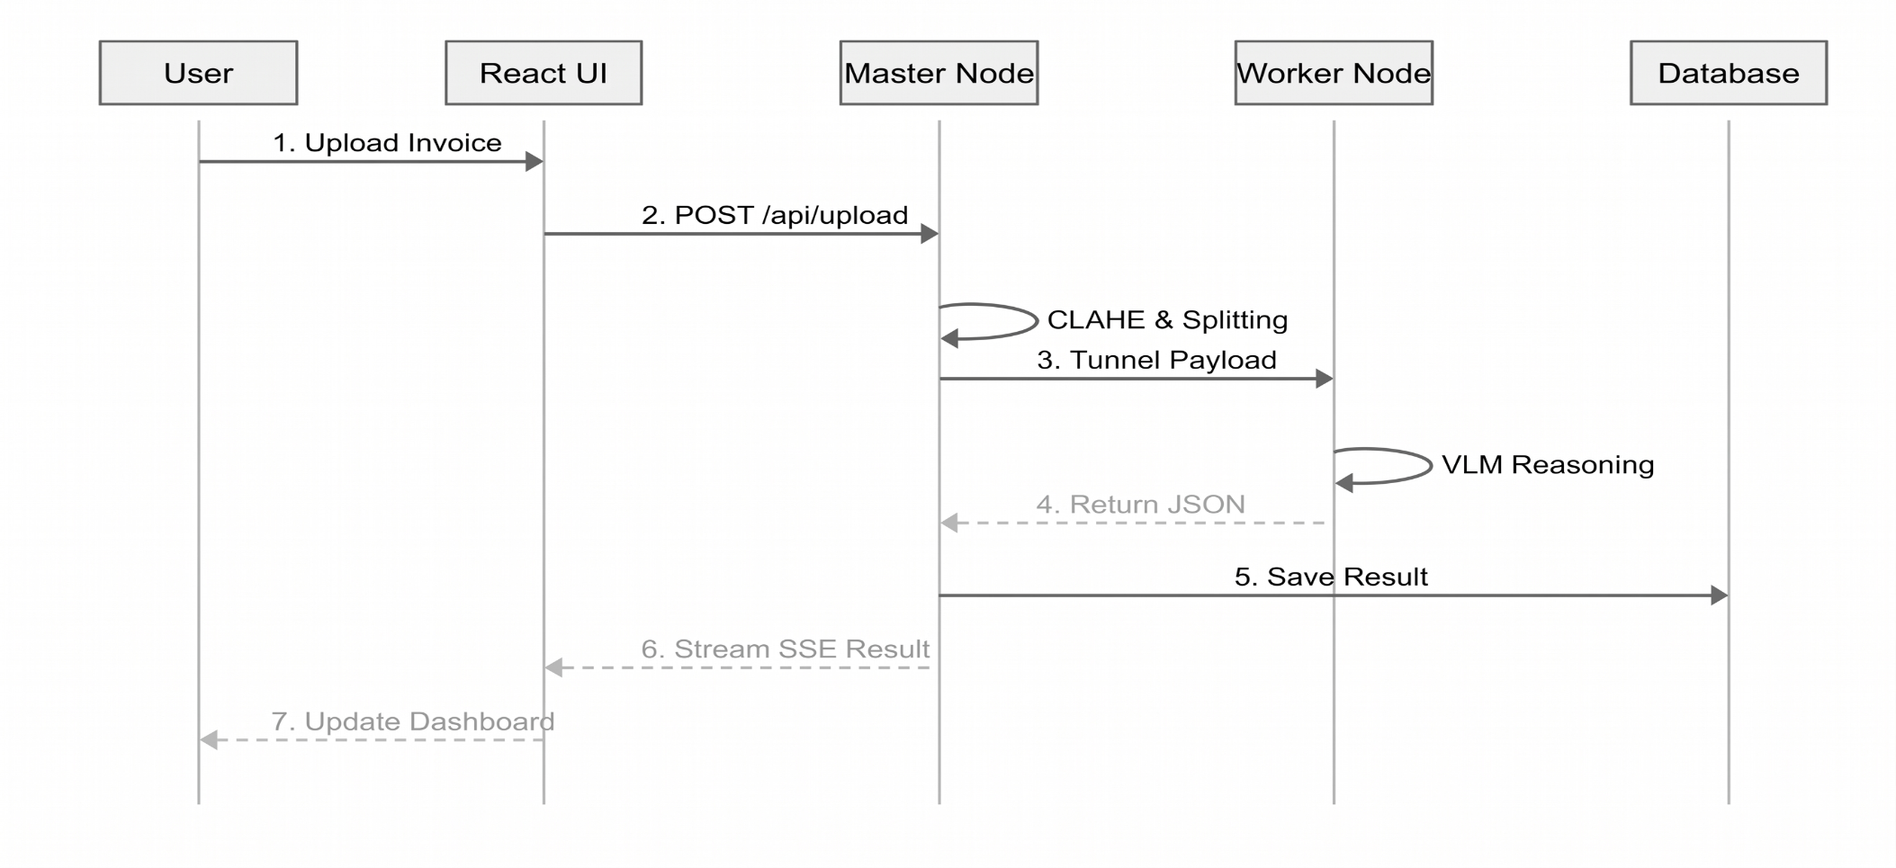
UML Diagram

Slide 19
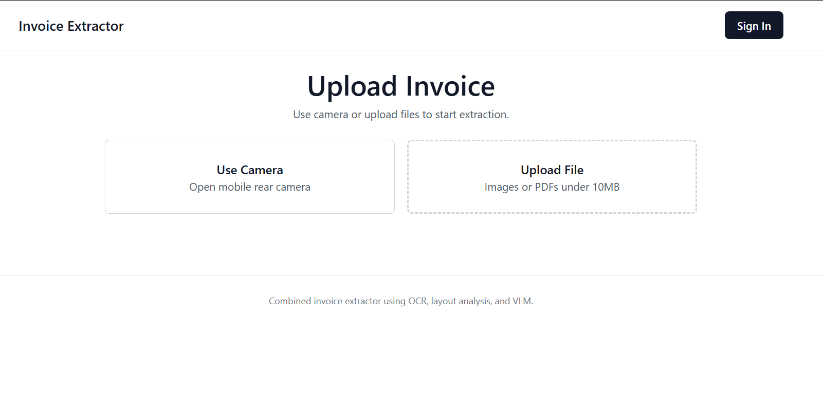
Result / Screenshot
Figure 1 - Home Screen

Slide 20
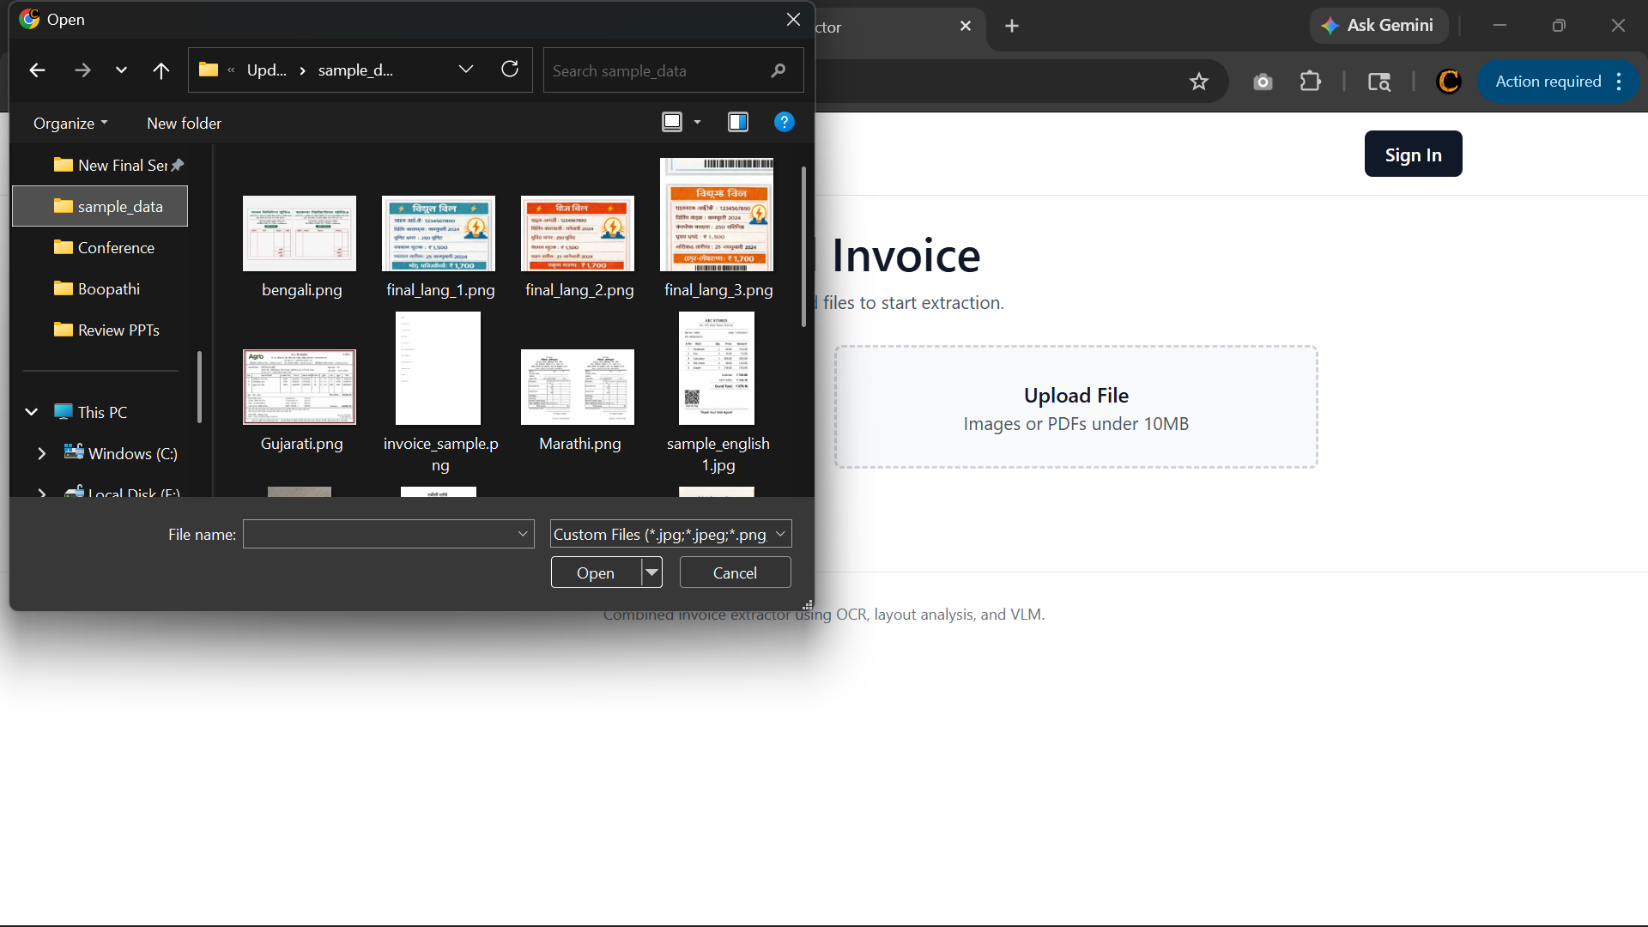
Result / Screenshot
Figure 2 – Upload Screen

Slide 21
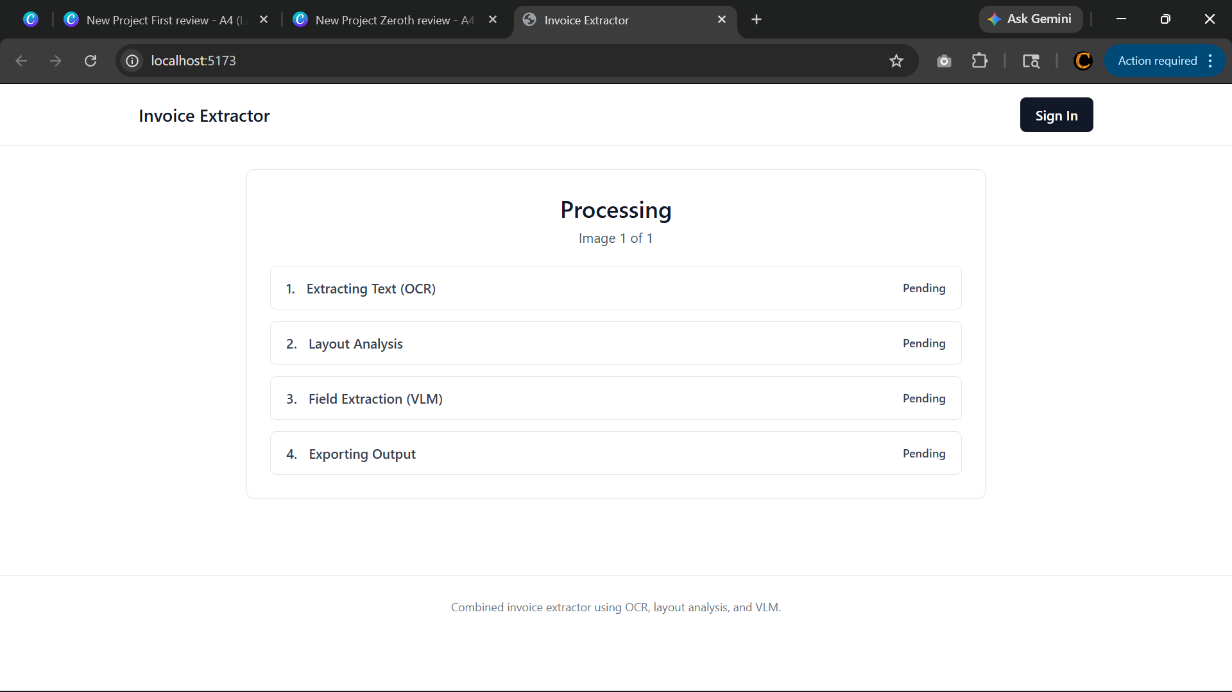
Result / Screenshot
Figure 3 – Processing Screen

Slide 22
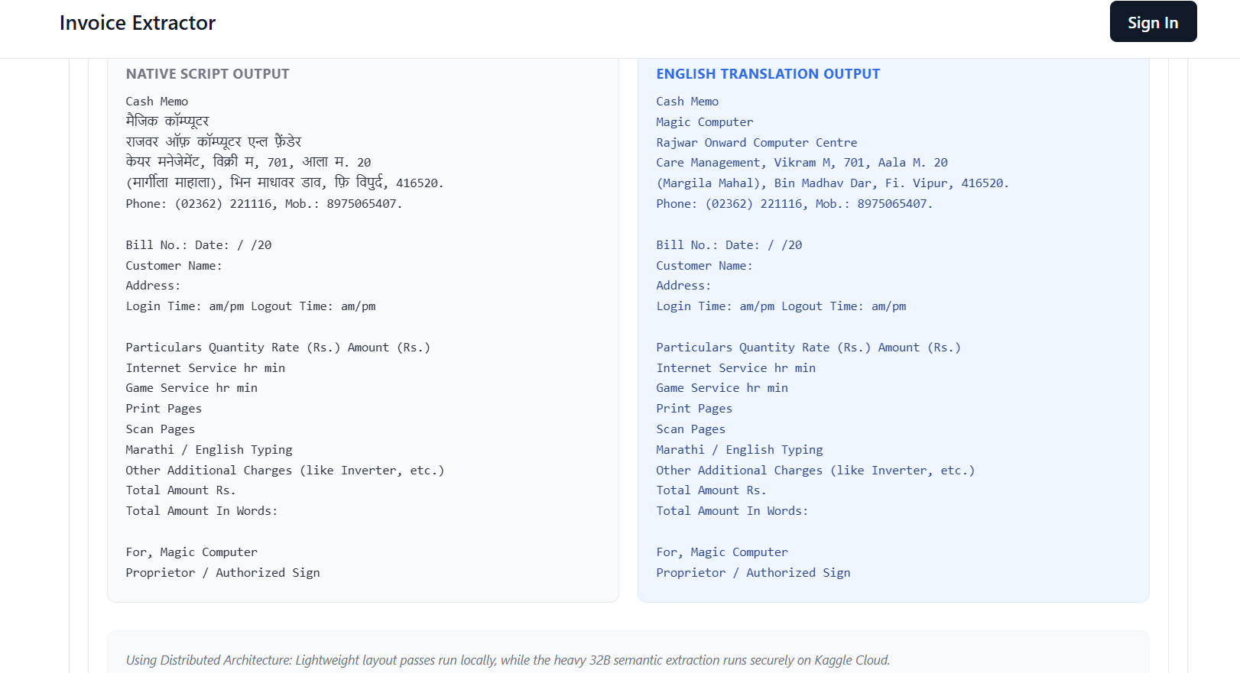
Result / Screenshot
Figure 4 – Output Screen

Slide 23
Future Enhancements
1. Seamless ERP & Cloud Ecosystem Integration: We aim to develop pre-built integration modules for global ERP platforms such as SAP S/4HANA, Oracle NetSuite, and Microsoft Dynamics 365. This would allow extracted financial data to flow directly into corporate accounting systems, tax filing portals, and supply chain management dashboards without any human intervention.
2. AI-Driven Fraud Detection & Signature Verification: Future iterations will include a comprehensive forensic analysis layer. This module will use secondary neural networks to detect digital tampering, check for inconsistent fonts, and perform automated signature verification against a secure database of authorized signers, adding a layer of security for high-value transactions.
.

Slide 24
Future Enhancements
3. Large-Scale Batch Processing & API Marketplace: To support enterprise-level workloads, we plan to implement a high-concurrency batch processing engine. This would allow for the simultaneous extraction of thousands of multi-page PDF documents and images, eventually offering this as an AI-as-a-Service (AIaaS) platform for third-party developers.
4. Continuous Learning & Self-Correction Feedback Loop: By implementing a Human-in-the-Loop (HITL) feedback system, the AI can learn from manual corrections. Every time a user corrects a minor extraction error, the system will store that data to periodically fine-tune the model, progressively increasing its accuracy for unique, customer-specific invoice formats.

Slide 25
Conclusion
In conclusion, this project successfully demonstrates a robust and scalable method for automating financial document processing using modern Vision-Language Models. By overcoming local hardware limitations through distributed offloading and implementing advanced pre-processing algorithms, we have created a system that is both highly accurate and adaptable to various invoice formats and languages. This solution significantly reduces the need for manual data entry and provides a foundation for seamless integration into larger enterprise ERP ecosystems, ultimately improving the speed and reliability of financial data management.

Slide 26

References
1. Huang, Y., et al. (2022). "LayoutLMv3: Pre-training for Document AI with Unified Text and Image Masking." Proceedings of the 30th ACM International Conference on Multimedia.
2. Bai, J., et al. (2024). "Qwen2-VL: Enhancing Vision-Language Models' Understanding of the World at Different Resolutions." arXiv preprint arXiv:2409.12191.
3. Du, Y., et al. (2020). "PP-OCR: A Practical Ultra Lightweight OCR System." arXiv preprint arXiv:2009.09941.
4. Multimodal & Transformer Architecture 4. Vaswani, A., et al. (2017). "Attention is All You Need." Advances in Neural Information Processing Systems (NeurIPS).

Slide 27
References
5. Dosovitskiy, A., et al. (2020). "An Image is Worth 16x16 Words: Transformers for Image Recognition at Scale." International Conference on Learning Representations (ICLR).
6. Hu, S., et al. (2024). "MiniCPM-V: A GPT-4V Level Multimodal LLM on Your Phone." OpenBMB Research.
7. Pizer, S. M., et al. (1987). "Adaptive Histogram Equalization and Its Variations." Computer Vision, Graphics, and Image Processing. (Reference for CLAHE).
8. Reisswig, C. (2021). "Distributed Inference for Large Language Models." Journal of Machine Learning Systems.

Slide 28
References
9. VanderPlas, J. (2016). "Python Data Science Handbook: Essential Tools for Working with Data." O'Reilly Media.
Technical Frameworks & Documentation
10. FastAPI Documentation. "FastAPI: A modern, fast (high-performance), web framework for building APIs with Python." https://fastapi.tiangolo.com/
11. MongoDB Manual. "NoSQL Database Management for Document-Oriented Data." https://www.mongodb.com/docs/
12. Cloudflare Argo Tunnel Documentation. "Secure Cloud-to-Edge Communication." https://developers.cloudflare.com/cloudflare-one/

Slide 29

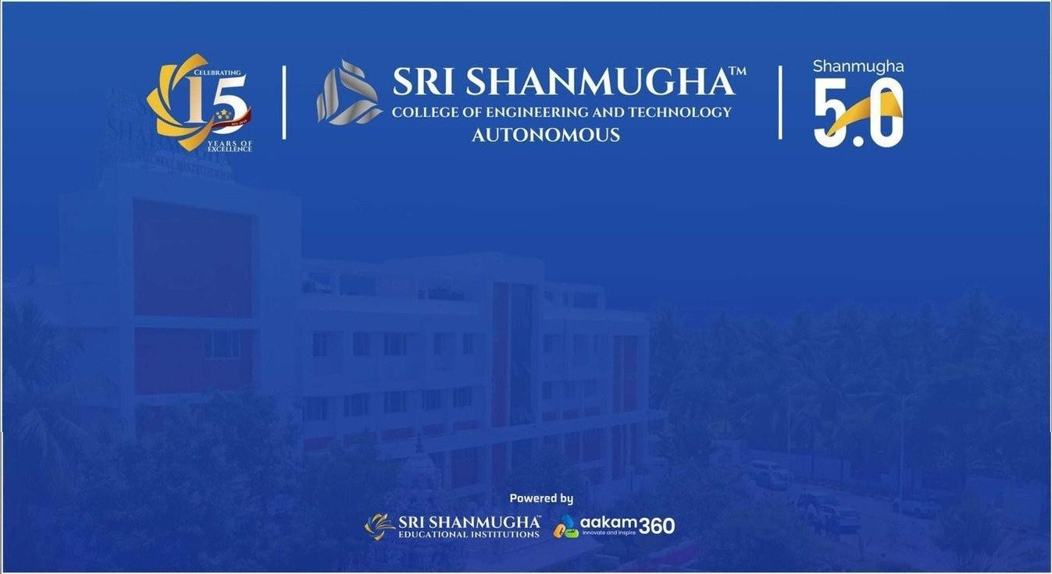
THANK YOU

